Slide 1
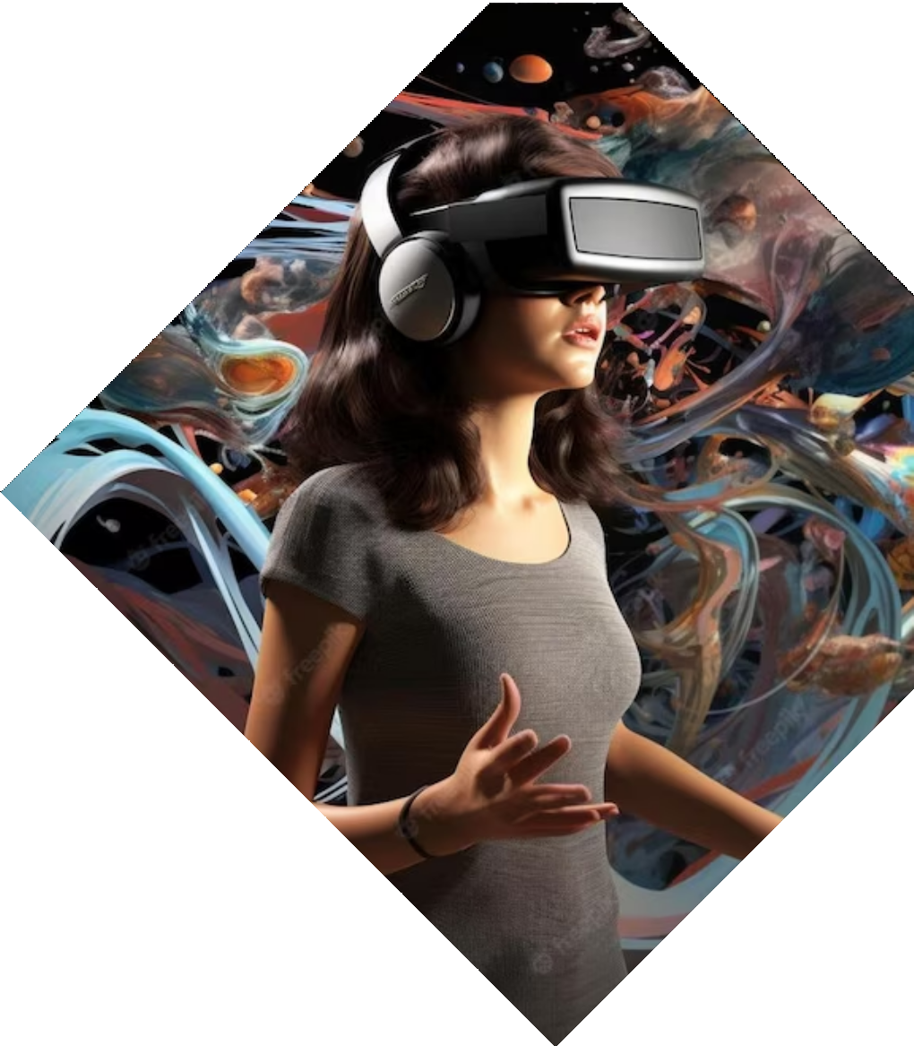
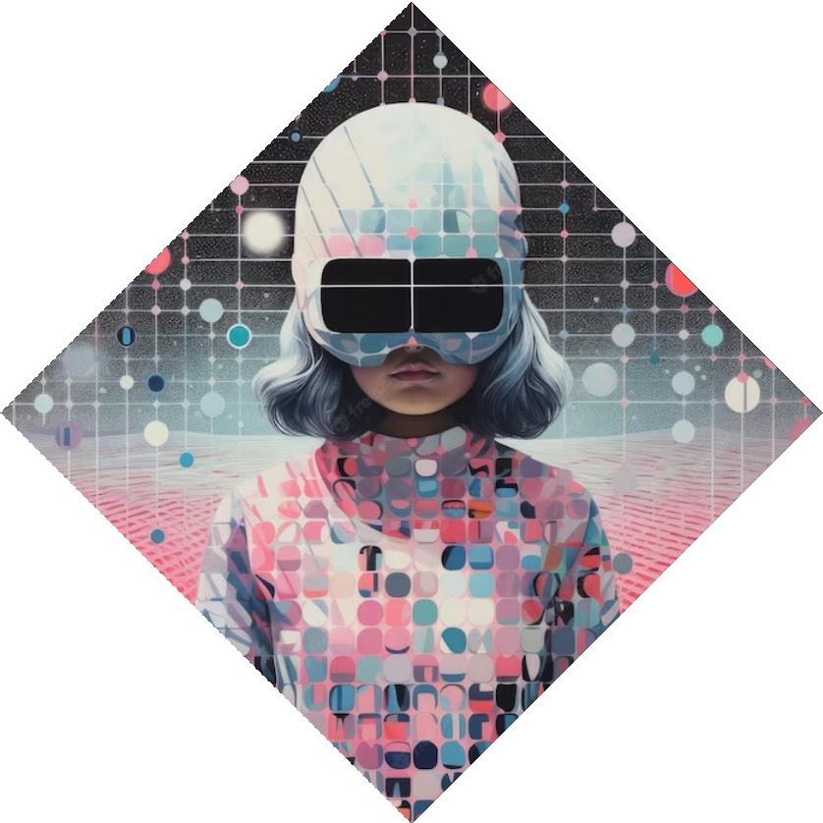
Revolutionizing Art Appreciation: Unveiling the Virtual Gallery Project

Slide 2

Introduction
Welcome to the presentation on Revolutionizing Art Appreciation: Unveiling the Virtual Gallery Project. This project aims to transform the way we experience art by leveraging virtual reality technology. Join us as we explore the exciting possibilities of immersing ourselves in a virtual art gallery.

Slide 3
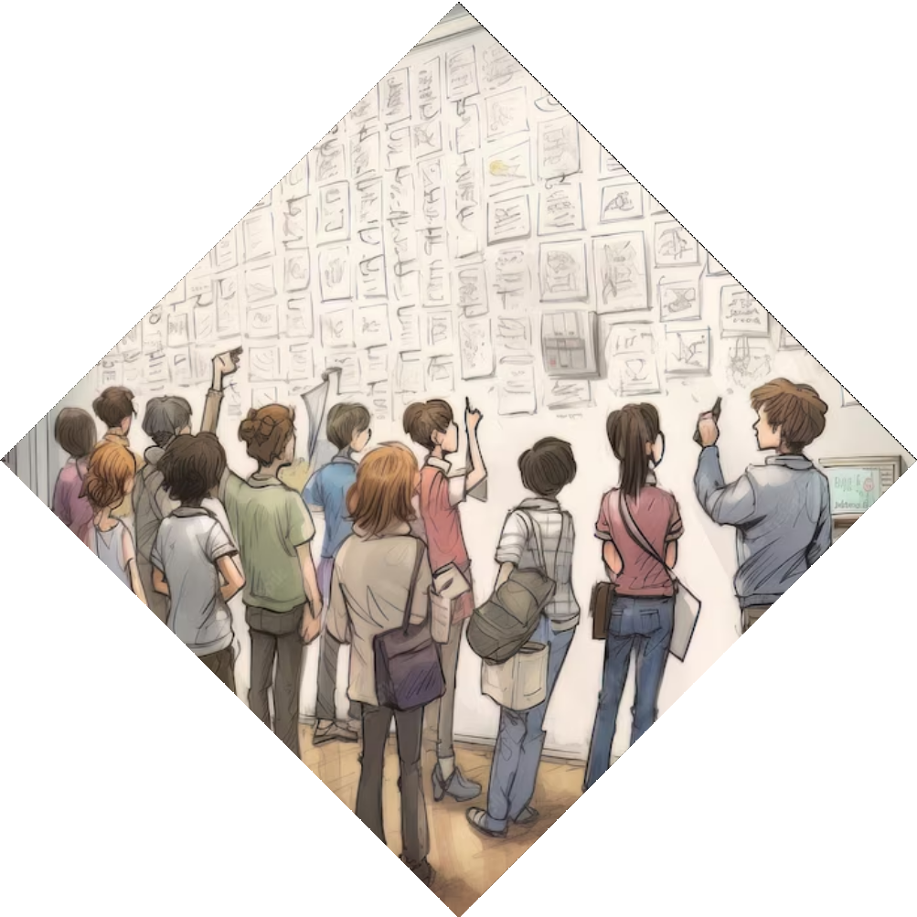
Traditional Art Appreciation
Art appreciation has traditionally been limited to physical visits to museums and galleries. This often poses challenges such as limited accessibility, crowded spaces, and time constraints. Our Virtual Gallery Project seeks to overcome these limitations by bringing the art to you, anytime and anywhere.

Slide 4
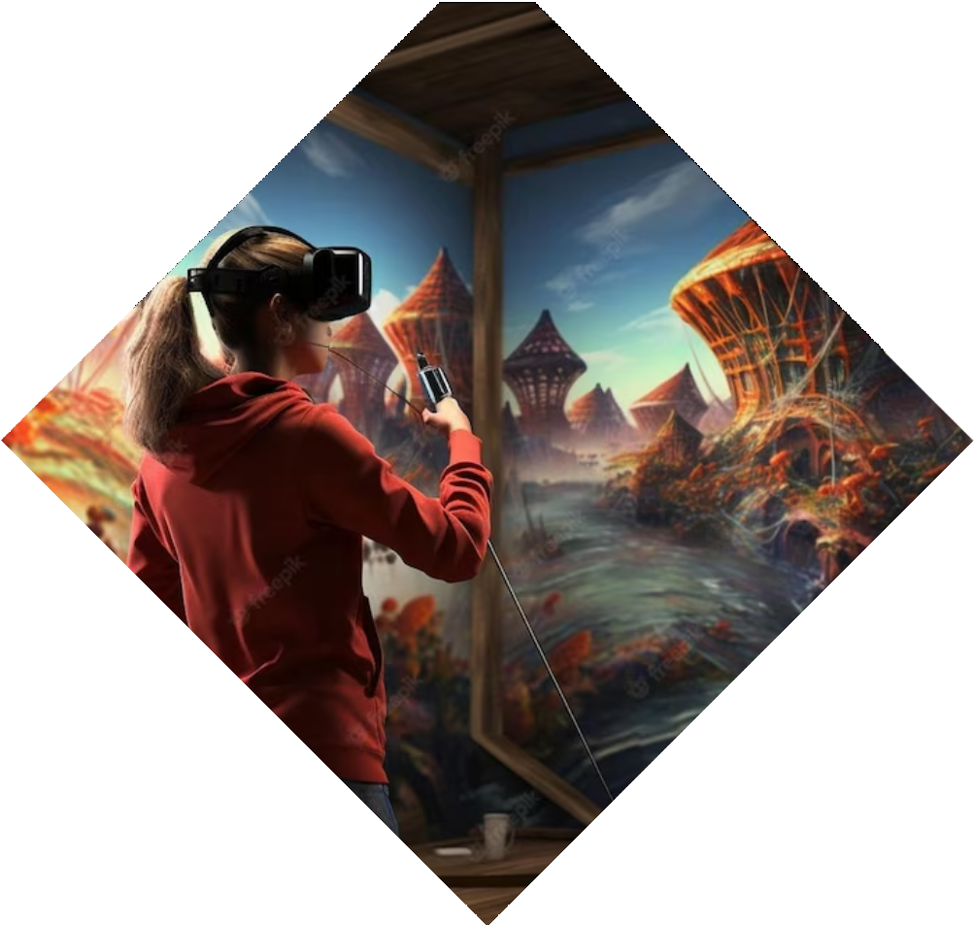
Immersive Virtual Reality
Our Virtual Gallery Project utilizes
cutting-edge virtual reality technology to create an immersive art experience. By putting on a VR headset, users can step into a virtual gallery, where they can walk around, interact with and appreciate artworks in a realistic and engaging manner.

Slide 5
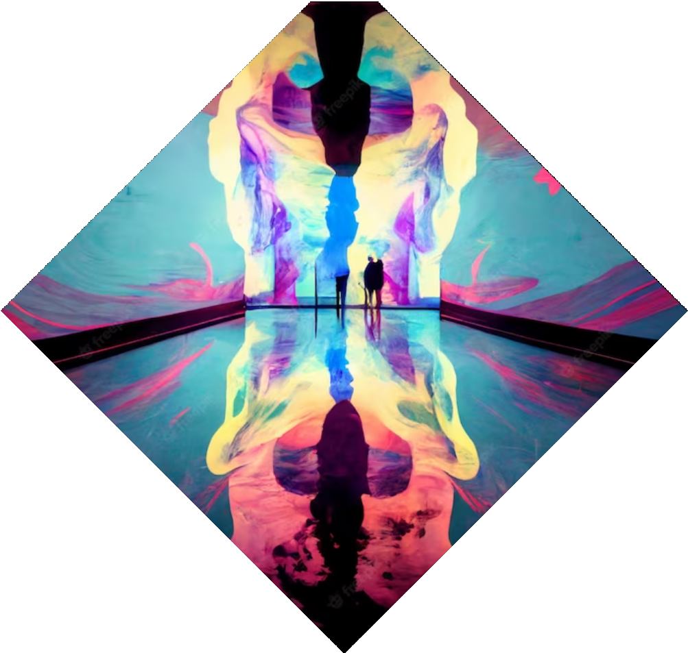
Expanding Artistic Boundaries
The Virtual Gallery Project opens up new possibilities for artists to push boundaries and experiment with their creations. With virtual reality, artists can showcase their works in unique and interactive ways, allowing viewers to experience art like never before. This technology presents a revolutionary shift in the art world.

Slide 6
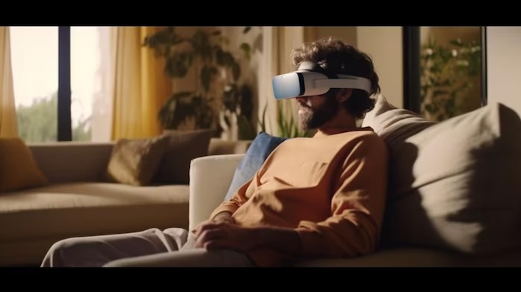
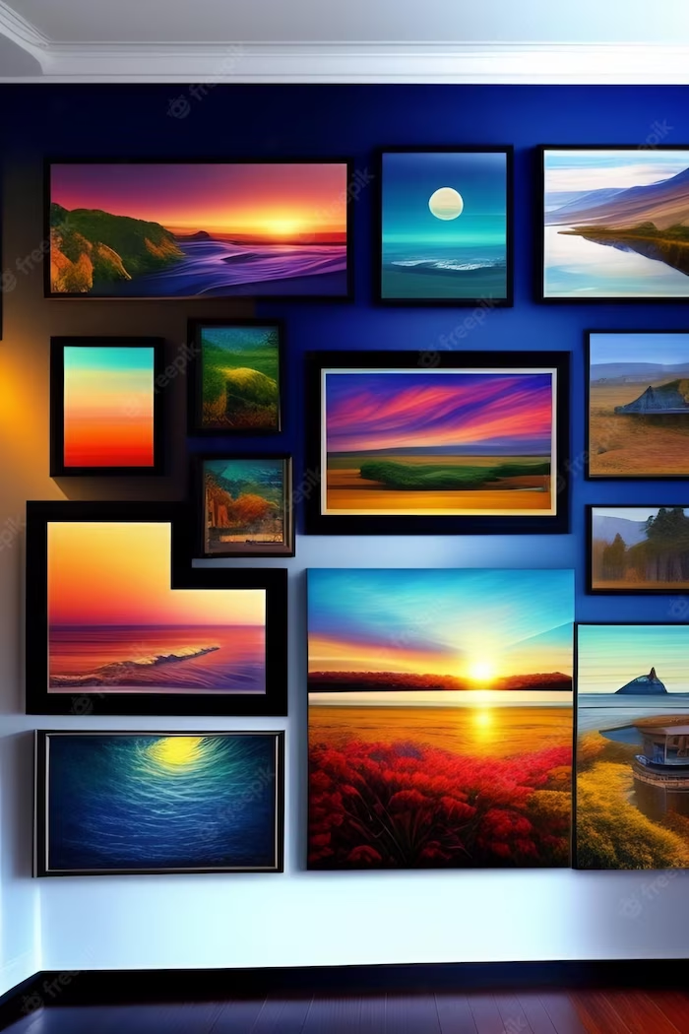
Enhancing Accessibility
One of the key advantages of the Virtual Gallery Project is its ability to enhance accessibility to art. People who face physical limitations, geographical constraints, or time restrictions can now explore and appreciate art from the comfort of their own homes. This inclusive approach ensures that art becomes more accessible to a wider
audience.

Slide 7
Conclusion
The Virtual Gallery Project revolutionizes art appreciation by leveraging virtual reality technology to create an immersive and accessible art experience.
By breaking free from the limitations of physical
spaces, this project enables us to explore art in new and exciting ways. Join us on this journey as we redeﬁne the future of art appreciation.

Slide 8
Thanks!
Do you have any questions?

